Slide 1
Microsoft TFS Environment Dogfooding TFS Server Statistics as of January 2011 Servicing organizations such as MSIT, DevDiv, Windows, SQL, AdCenter, MSN/Windows Live, Bing Mobile, Windows Azure, MEDPG, and HED The Developer Division instance has over ~3,700+ active users and processes over 100M+ source control and work item tracking requests per day
Users
Active users: 25, 960
Unique users: 17,322
Source Code Files
Files: 101,486,122
Team Projects
6,750
Work Items
8,734,391
Monthly Team Builds
1,134,310
Availability
99.83% uptime
Proxy Server
6 proxies configured serving a load of 100,000,000+ requests per week
700 GB SAN ea.
Hardware
App Tier: 8-way, 2x HP ProLiant with 16GB of RAM
64-Bit Windows Server 2008 R2
Reporting Services are installed.
Load Balanced
Data Tier-Single Instance: 24-way, 2x HP with 128GB of RAM
64-Bit Windows Server 2008 R2
Failover cluster configuration
400 dedicated spindles
60 TB of storage total

Slide 2
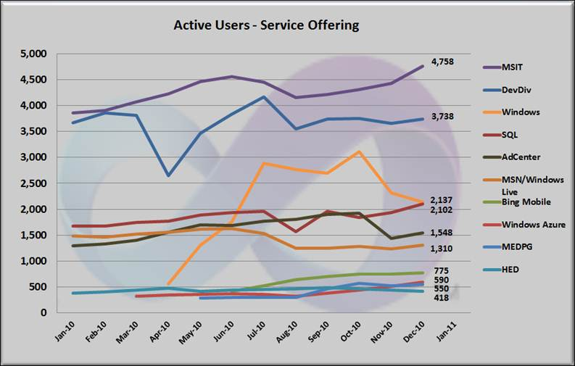
Microsoft TFS Environment All Active Users

Slide 3
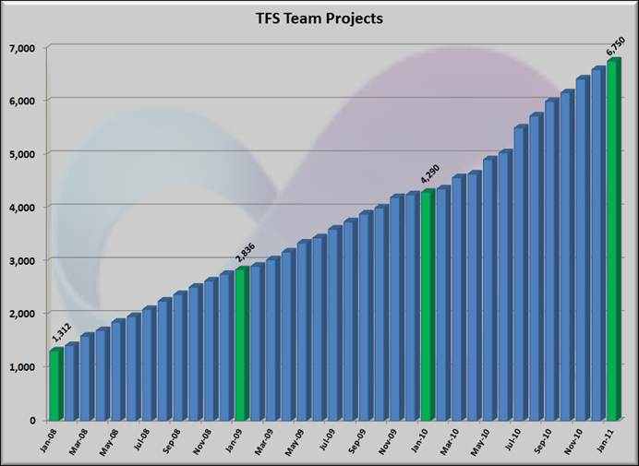
Microsoft TFS Environment TFS Team Projects

Slide 4
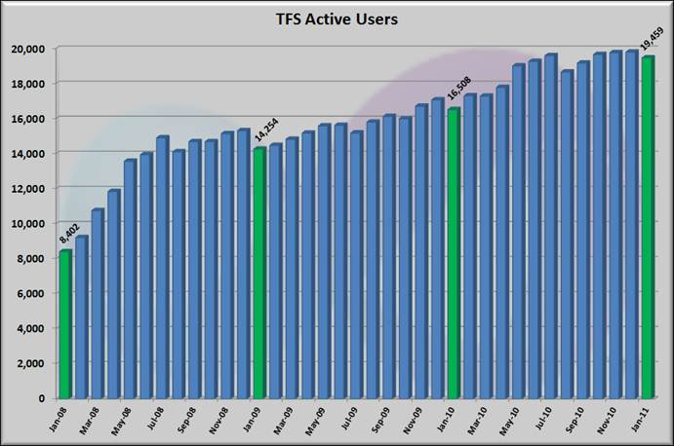
Microsoft TFS Environment All Active Unique Users

Slide 5
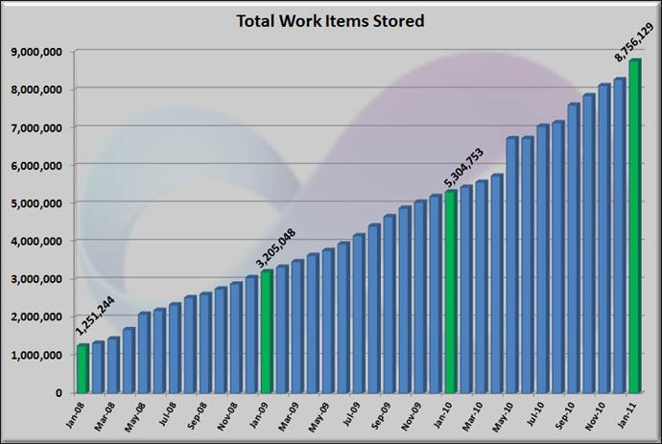
Microsoft TFS Environment Total Work Items

Slide 6
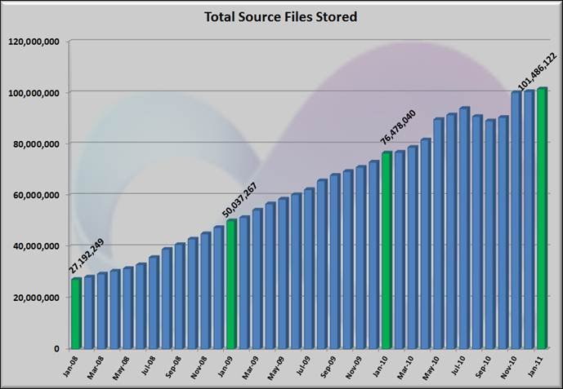
Microsoft TFS Environment Source Code Files

